Slide 1

Cloud Computing
Abilash S.R

Slide 2
What is Cloud?
The cloud is not a physical entity, but instead is a vast network of remote servers around the globe which are hooked together and meant to operate as a single ecosystem.
These servers are designed to either store and manage data, run applications or deliver content or a service such as streaming videos, web mail, office productivity software or social media
The information will be available anywhere you go and anytime you need it.

Slide 3
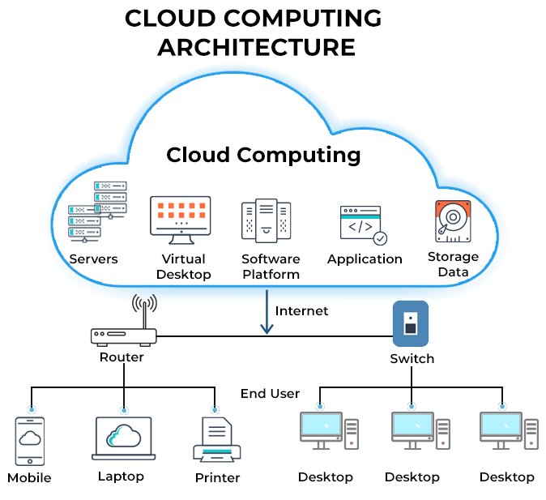

Slide 4
What is cloud Computing ?
Cloud computing refers to the use of hosted services, such as data storage, servers, databases, networking, and software over the internet.
The data is stored on physical servers, which are maintained by a cloud service provider.
Instead of buying, owning, and maintaining physical data centers and servers, you can access technology services, such as computing power, storage, and databases, on an as-needed basis from a cloud provider (Azure,AWS,GCP)

Slide 5
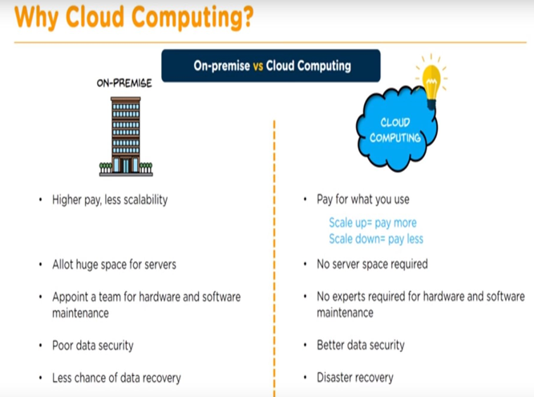
Why ?

Slide 6
ADVANTAGES

Slide 7
Disadvantages
Risk of data confidentiality. There is always a risk that user data can be accessed by other people
Speed may vary depends on internet connection
Technical problem(you must contact customer support who is not necessarily ready 24/7. This is a problem because for some support you also have to pay more money).
The level of security(cloud computing system means we are fully entrusted with the security and confidentiality of data to companies that provide cloud computing servers).

Slide 8
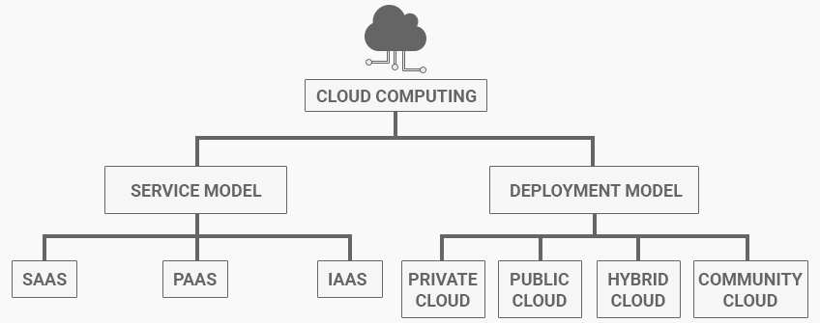

Slide 9
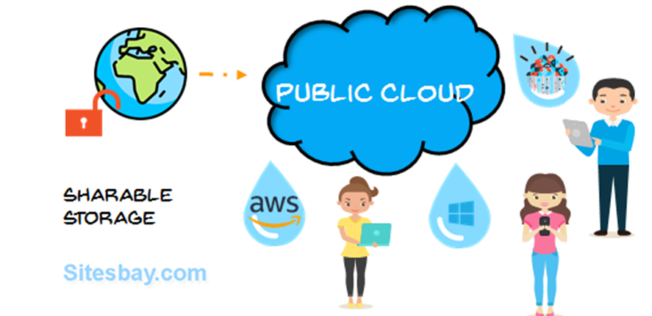
Deployment Models (Public cloud)
Public cloud: Allows system and service accessed in public :ex: Gmail, Microsoft 365, Dropbox, Microsoft Azure, and Amazon AWS.

Slide 10
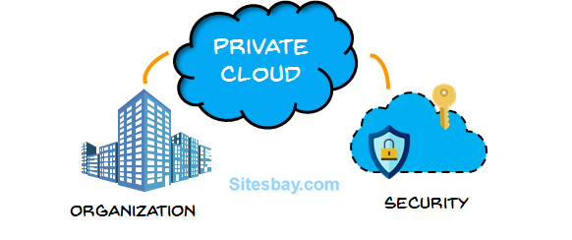
Deployment Models (Private cloud)
Private cloud: private cloud allows system or service accessed inside organization :ex any intranet service

Slide 11
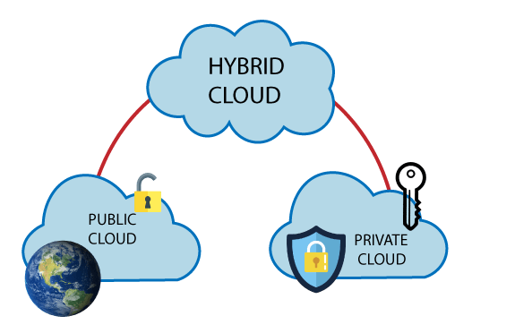
Deployment Models (Hybrid cloud)
Hybrid cloud: mixture of public and private cloud critical activities are performed using private cloud and non critical activities are performed using public cloud

Slide 12
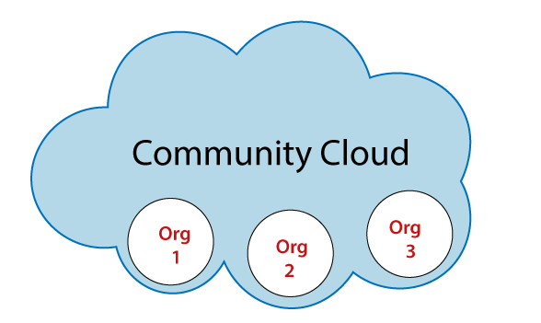
Deployment Models (Community cloud)
Community cloud: Can be accessed with a group of organization ex: IBM+UST+INFOSYS

Slide 13
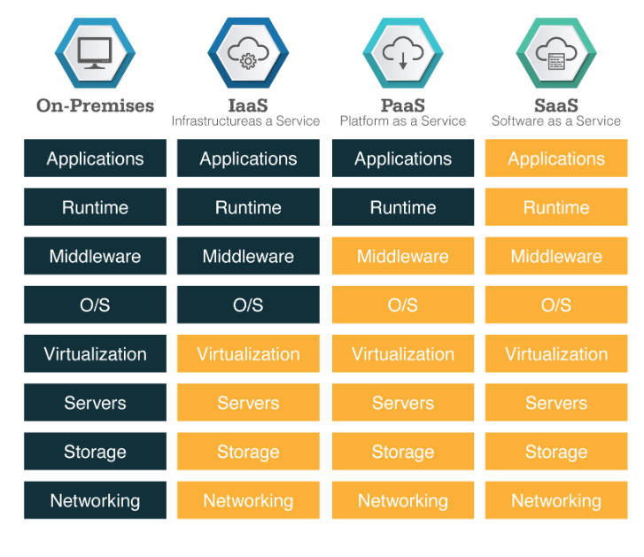

Slide 14
IAAS key points
IaaS is a cloud service that provides services on “pay-for-what-you-use” basis You can dynamically choose a CPU, memory and storage configuration as per your needs.
Disadvantage
IaaS cloud computing platform can limit the user privacy and customization options.
Examples: AWS,AZURE,DigitalOcean

Slide 15
paaS key points
Platform-as-a-service (PaaS) is a type of cloud computing offering in which a service provider delivers a platform to clients, enabling them to develop, run, and manage business applications without the need to build and maintain the infrastructure
Disadvantage
Not every part of your company's existing infrastructure may be built for the cloud
Examples: Google App Engine, AWS Elastic Beanstalk

Slide 16
saaS key points
Software as a service is a software licensing and delivery model in which software is licensed on a subscription basis and is centrally hosted. It is sometimes referred to as "on-demand software", and was formerly referred to as "software plus services“
Disadvantage
Insufficient Data Security, Troublesome Software Integration,
Examples:Hubspot,Dropbox

